Slide 1
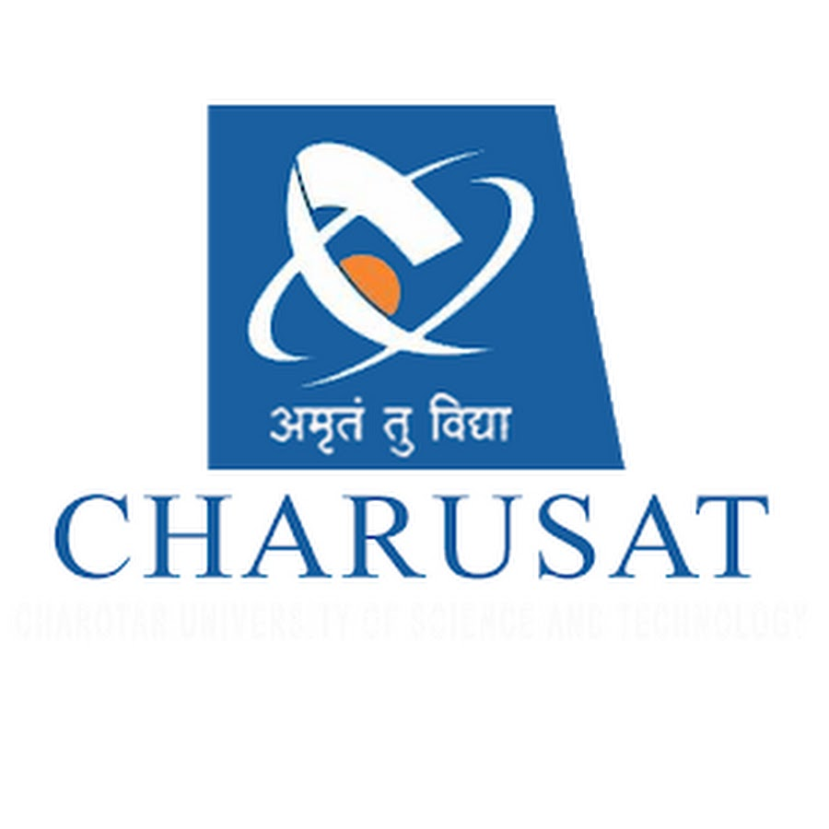

ARDUINO BASED SUN TRACKING SOLAR PANEL
PREPARED BY: GUIDED BY:
18IT074- DHWANI PAREKH Prof. HARSH PATEL
18IT090- KRUPA PATEL

Slide 2
ABSTRACT:
We have make a Sun Tracking Solar Panel Using Arduino, which will sense the light and automatically rotate the solar panel in the direction of the sun light.
Aim of this project is to get the maximum amount of solar energy which can be use in all the day to day works which needs electricity by increasing the efficiency.
Advantage of this project is that Solar panel will always follow the sun light and it will always face towards the sun to get charge all the time and can provide the maximum power.

Slide 3
INTRODUCTION:
Solar energy is the energy obtained by capturing heat and light from the Sun. Energy from the Sun is referred to as solar energy.
Technology has provided a number of ways to utilize this abundant resource. It is considered a green technology because it does not emit greenhouse gases. Solar energy is abundantly available and has been utilized since long both as electricity and as a source of heat.

Slide 4
When people think about alternative or renewable energy, the first image that comes to mind is often large blue or black solar panels on rooftops or portable highway signs that have a small panel attached.
These solar panels, also known as photovoltaic modules (or PV modules), convert sunlight into electricity, and they have been the backbone of renewable energy for decades.
The Photovoltaic Effect (how sunlight is converted into electrical energy) was discovered over a hundred years ago! Yet widespread implementation of this technology has been very gradual. Only in very recent years has photovoltaics gained wide popularity as an alternative way to produce electricity.

Slide 5
COMPONENTS
Arduino UNO
Servo Motor
Battery
Light Sensors
LDR
10k Resistors

Slide 6
WHAT IT DOES?
A solar tracking system maximizes the solar system electricity production by moving the panels to follow the sun throughout the day, which optimizes the angle at which the panels receive solar radiation.
These setups allow your panels to move and rotate according to the movement of the sun.
The longer they are towards the sun, the more energy they can produce as they could capture more amount of solar power.

Slide 7
WORKING
In this project, LDR’s are working as light detectors.
LDR (Light Dependent Resistor) also known as photo resistor is the light sensitive device. Its resistance decrease when the light falls on it and that’s why it is frequently used in Dark or light detecting circuits.
The two LDR’s are placed at the two sides of solar panel and the Servo Motor is used to rotate the solar panel.
The servo will move the solar panel towards the LDR whose resistance will be low, mean towards the LDR on which light is falling, that way it will keep following the light.

Slide 8
WORKING CONTINUE…
And if there is same amount of light falling on both the LDR, then servo will not rotate.
The servo will try to move the solar panel in the position where both LDR’s will have the same resistance means where same amount of light will fall on both the resistors and if resistance of one of the LDR will change then it rotates towards lower resistance LDR.

Slide 9
ADVANTAGES:
Trackers generate more electricity than their stationary counterparts due to increased direct exposure to solar rays.
Solar trackers generate more electricity in roughly the same amount of space needed for fixed-tilt systems, making them ideal for optimizing land usage.
In certain states, some utilities offer Time of Use (TOU) rate plans for solar power, which means the utility will purchase the power generated during the peak time of the day at a higher rate. In this case, it is beneficial to generate a greater amount of electricity during these peak times of the day. Using a tracking system helps maximize the energy gains during these peak time periods.
Advancements in technology and reliability in electronics and mechanics have drastically reduced long-term maintenance concerns for tracking systems.

Slide 10
LIMITATIONS:
Solar trackers are slightly more expensive than their stationary counterparts, due to the more complex technology and moving parts necessary for their operation.
Even with the advancements in reliability, there is generally more maintenance required than a traditional fixed rack, though the quality of the solar tracker can play a role in how much and how often this maintenance is needed.
Trackers are a more complex system than fixed racking. This means that typically more site preparation is needed, including additional trenching for wiring and some additional grading.

Slide 11
Conclusion:
Thus the voltage received from solar tracking system is more than the static solar panel. Comparing the total net electricity generation of the fixed position and smart solar tracking control, the smart system yields greater efficiency than the fixed system.

Slide 12
Thank you

